Slide 1
The event will begin momentarily.
This event is being recorded
Captions are available by clicking the CC icon in the Zoom toolbar below
ASL is provided
For more information and to download presentation materials visit: www.access-board.gov/av/

Slide 2




Inclusive Design of Autonomous Vehicles: A Public Dialogue
Accessibility for Passengers with Mobility Disabilities: Part 1 Entering and Exiting Vehicles

Slide 3
Agenda
Presentations
U. S. Access Board – Randall Duchesneau
University at Buffalo – Dr. Victor Paquet
Q & A
NMEDA – Amy Schoppman
BraunAbility – Kevin Frayne
Q & A
Open Dialogue
Dialogue continues online
https://transportationinnovation.ideascale.com/
PowerPoint slides available for download at:
https://www.access-board.gov/av/

Slide 4
How to Participate
Ask Questions to Presenters
Submit questions using Zoom’s Q & A feature throughout the event
Moderator will read question
May not get to all questions
Alternative : Email events@access-board.gov
Contribute to Open Discussion
Request to speak using Zoom’s Q & A feature
Ex. I’m Beth from XYZ Company and would like to talk about automated doors
Ex. I’m Alex and I’d like to share my experience using an AV
Host will enable your microphone
Moderator will call on you to unmute and speak
ASL – if you wish to be visible for signing, indicate in request
Online dialogue
https://transportationinnovation.ideascale.com/
For assistance, email: ePolicyWorks@dol.gov

Slide 5
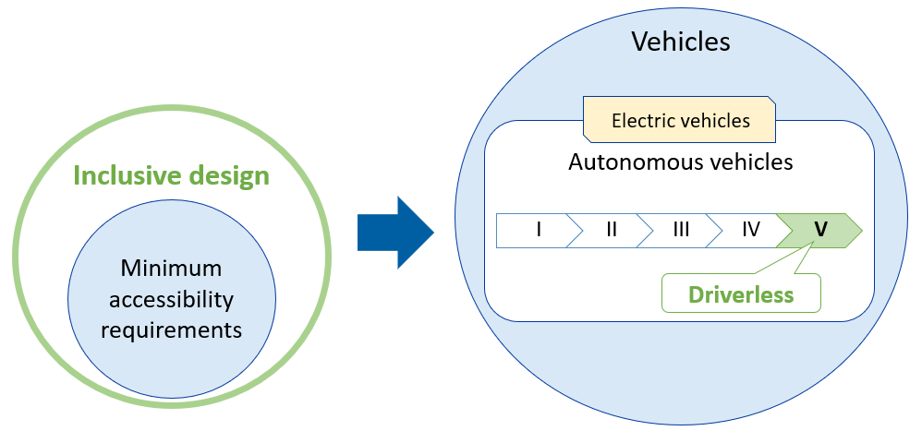
“inclusive design of autonomous vehicles”

Slide 6
Existing Accessibility Guidelines
ADA Accessibility Guidelines for Transportation Vehicles (1991, 1998)
https://www.access-board.gov/ada/vehicles/
Updated Guidelines for Buses and Vans (2016)
https://www.access-board.gov/guidelines-standards/vehicles/update-buses-vans/guidelines-text/
For technical assistance on these guidelines:
800-872-2253 (v)
800-993-2822 (tty)
ta@access-board.gov

Slide 7
U. S. Access Board: Accessibility Guidelines for Buses and Vans
Randall Duchesneau, Accessibility Specialist

Slide 8
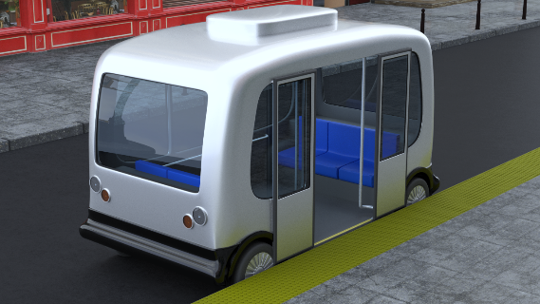
Technical Criteria
Walking Surfaces
Ramps and bridge plates
Slopes
Lifts
Level boarding
Steps
Doorways
Illumination
Entering and Exiting Vehicles
At least one means of accessible boarding and alighting (ramps or bridge plates, lifts, level boarding)
At least one means that can be deployed to the roadway

Slide 9
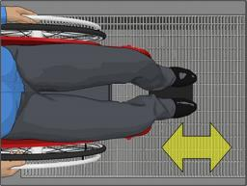
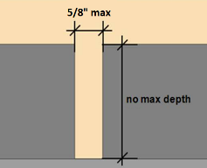
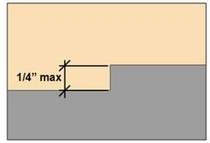
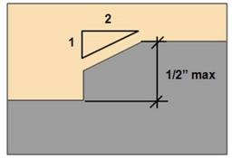
Surfaces
Slip resistant
Openings
5/8” sphere
Perpendicular to dominant direction of travel
Exception for wheelchair securement components and handles
Surface discontinuities
¼” vertical, ½” beveled at 1:2
Steps

Slide 10
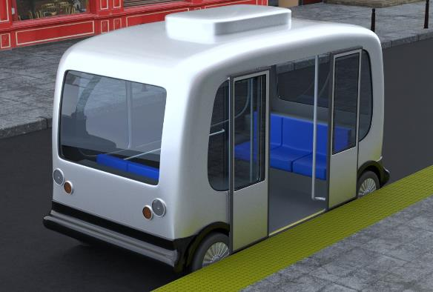
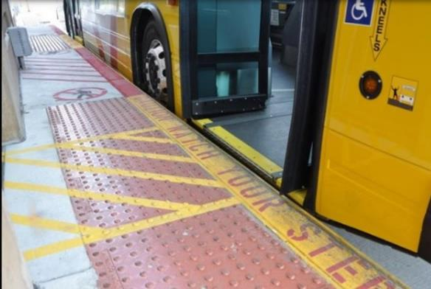
Level Boarding
Coordinated to minimize the gap between the vehicle floor and boarding platform
Ramp needed if gap is greater than 2” horizontal or 5/8” vertical

Slide 11
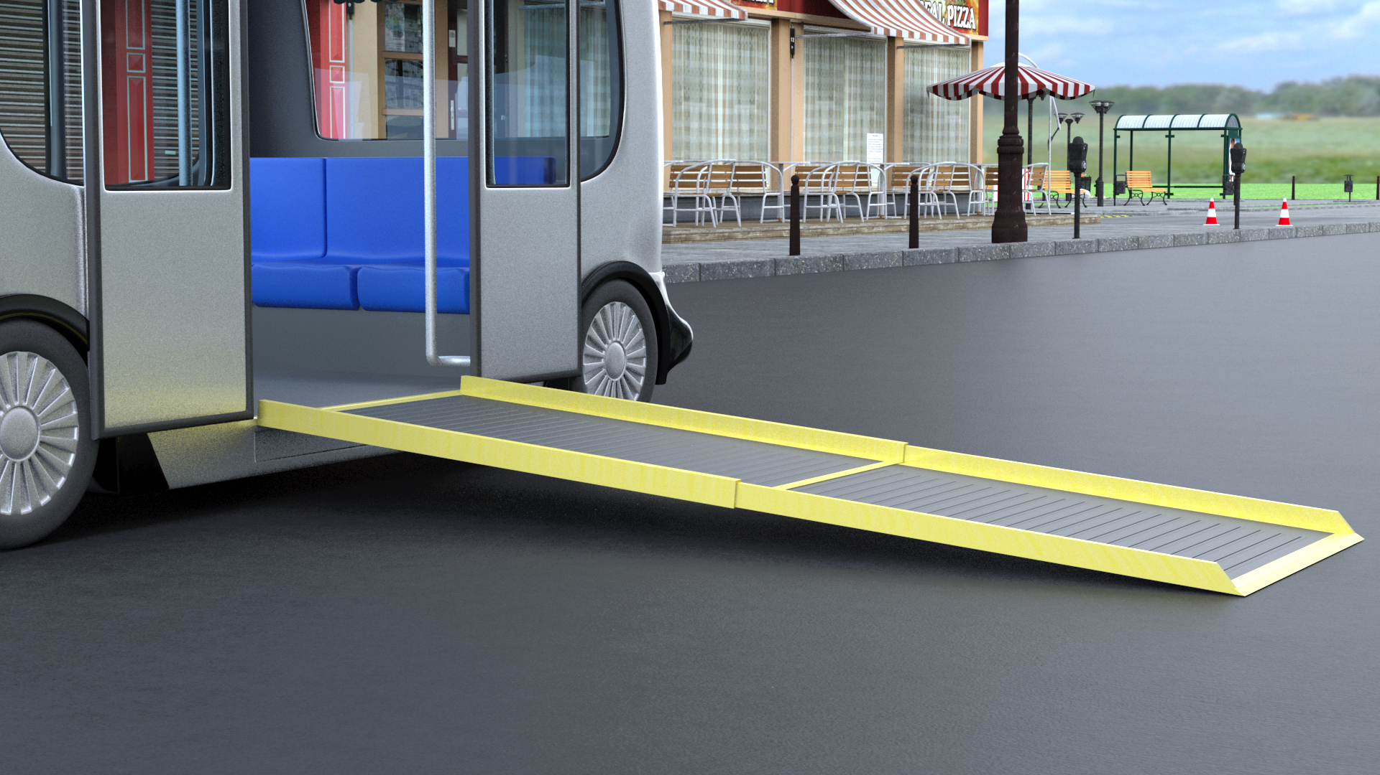
Ramps
Permitted to fold or telescope
Design load
600 pounds if longer than 30”
300 pounds if less than 30”
(Placed at the centroid of the ramp distributed over an area of 26” x 26”)
When in use, firmly attached to the vehicle
When not in use, means of storage (i.e. compartment / securement system)
Capable of manual operation (in case of power failure)

Slide 12

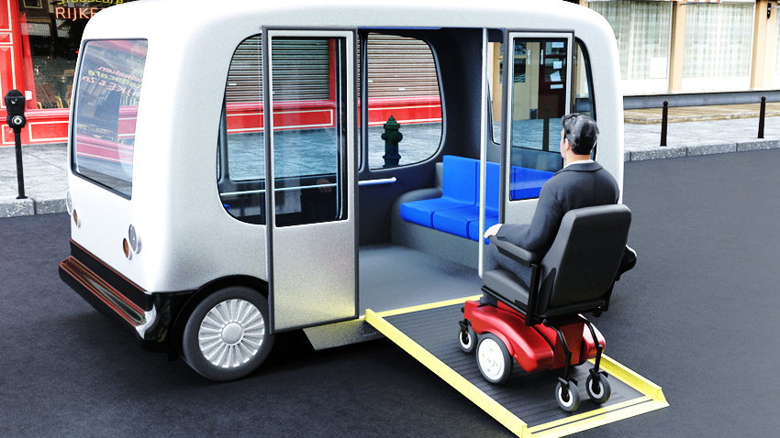
Ramp features
Clear width 30” wide (min.)
Edge guards
2” high (min.) along each side to within first 3”
Visual contrast
1” (min.) stripe along perimeter
Light on dark, or dark on light
Slopes

Slide 13
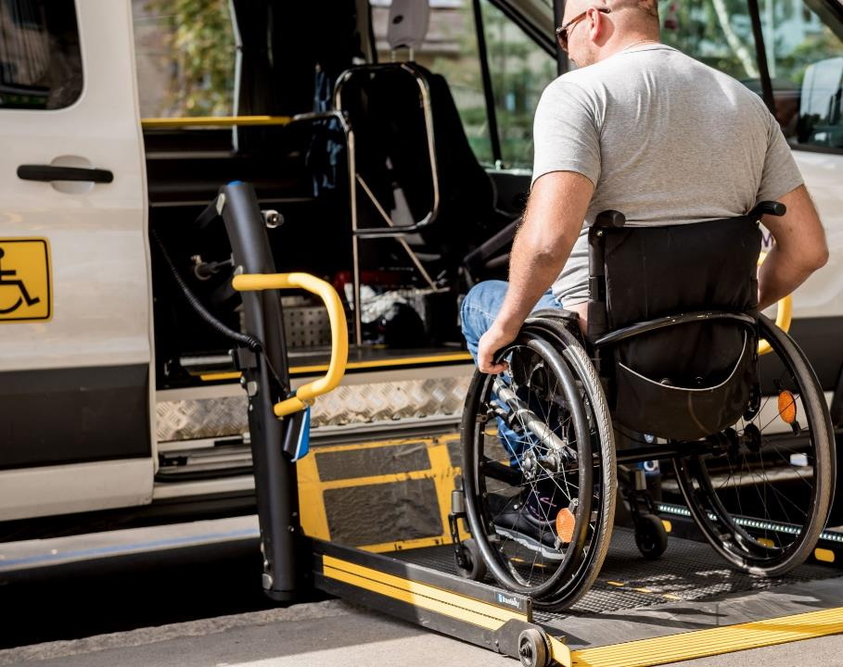
Lifts
Comply with NHTSA FMVSS:
49 CFR 571.403 and 571.404
Designed to permit boarding facing toward or away from vehicle

Slide 14
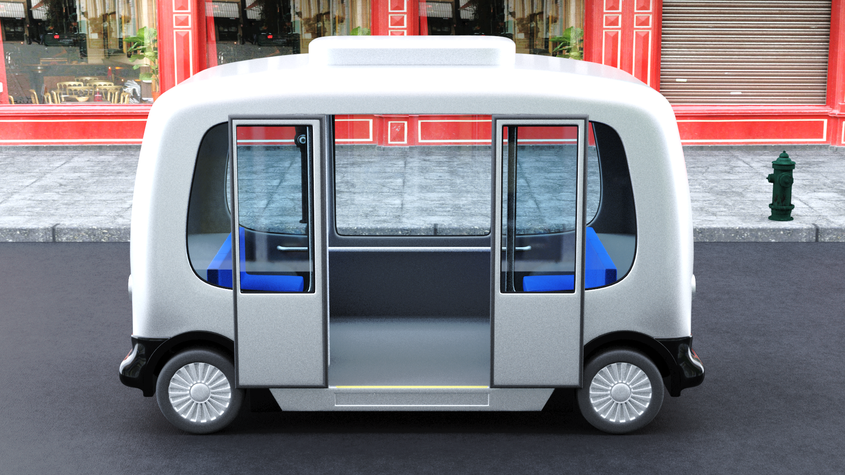
Doorways
Vertical clearance (min.)
Finished edge of door opening to highest points of the deployed lift, ramp or bridge plate below
Depends on size and type of vehicle
Over-the-road buses – 65”
Other vehicles < 25 feet – 56”
Other vehicles > 25 feet – 68”
[Buildings: 78” - 80”]
Clear width
32“ min. for doorways with level boarding
Thresholds marked with 1“ stripe
Notes:
Over-the-road bus means a bus characterized by an elevated passenger deck located over a baggage compartment.

Slide 15
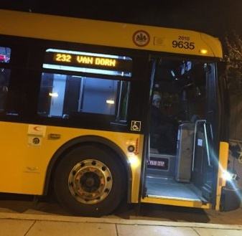
Illumination
Lights shielded (don’t project directly into eyes of passengers)
Required at ramps, bridgeplates, doorways
2 foot-candles (22 lux) min.
Required at boarding and alighting areas (exterior illumination)
3 feet (min.) beyond ramp/steps
1 foot-candle (11 lux) min.

Slide 16

Victor Paquet, ScD
Center for Inclusive Design and Environmental Access
University at Buffalo Department of Industrial and Systems Engineering

Slide 17
Accessibility for Passengers with Mobility Disabilities: Part 1 Boarding and Exiting
Victor Paquet, ScD
U.S. Access Board Public Forum on Autonomous Vehicles

Slide 18
Introduction
While ramps afford accessibility that stairs do not, all ramps are not created equal.
Boarding and exiting public transit vehicles via ramps can be challenging.
Today’s presentation will summarize the results of two vehicle ramp studies:
Study 1: Effects of ramp slope on human performance during ramp ascent and descent
Study 2: Effects of multi-segment ramp configuration on human performance during boarding and exiting in a simulated vehicle environment
Some of the findings can be applied to public autonomous public transit (i.e., public self-driving vehicles).

Slide 19
Study 1: Research Questions
What is the impact of ramp slope on the ramp ascent and descent performance of mobility aid users?
Does ramp slope have a differential effect on the performance of individuals who use different types of mobility aids?

Slide 20
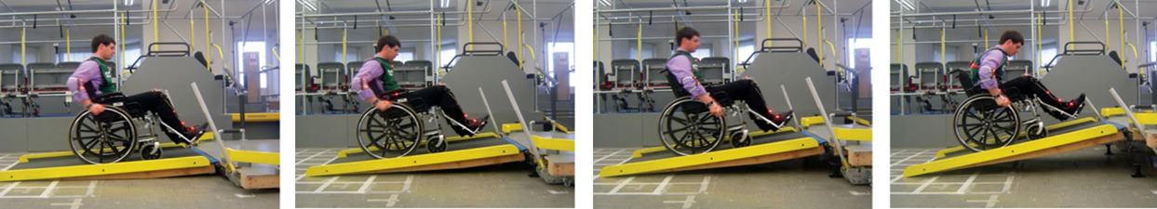
Study 1: Study Design (n=80)
Group | n | Age Range
Manual Wheelchair | 14 | 19-55
Power Wheelchair | 20 | 29-82
Scooters | 5 | 29-65
Cane/Service Animal (Visually Impaired) | 20 | 22-75
Other Walking Aid | 21 | 28-80
1:12
1:8
1:6
1:4

Slide 21
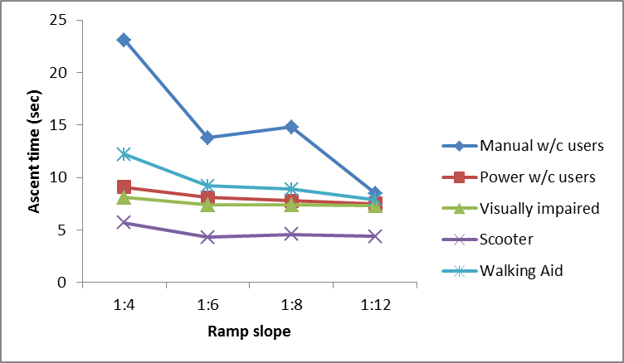
Study 1: Ramp Ascent Time
ANOVA: Main effects for user group (p<.001) & slope (p=.027).

Slide 22
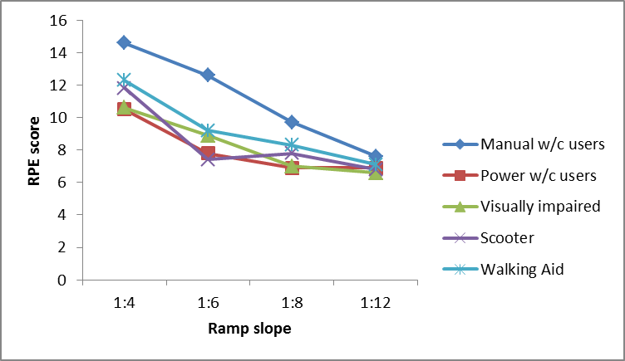
Study 1: Ratings of Perceived Exertion for Ramp Ascent
Hard
Somewhat Hard
Very light
ANOVA: Main effects for user group (p<.001) and slope (p<.001).

Slide 23
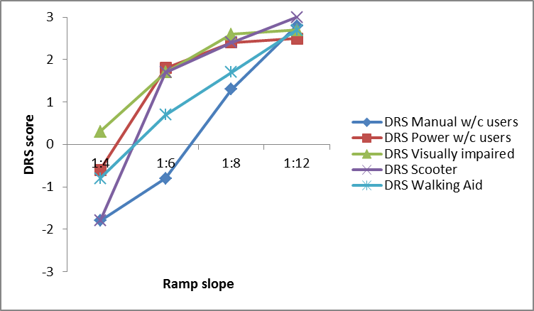
Study 1: Ratings of Perceived Difficulty for Ramp Ascent
Very Easy
Very Neither
Very
Difficult
ANOVA: Main effects for user group (p<.001) and slope (p<.001).

Slide 24
Study 1: Other Findings
Successful Use
1:4 – 9 (33%) could not complete trial
1:6 – 4 (14.8%) could not complete trial
1:8 – 1 (3.7%) could not complete trial
1:12 – all completed trial
Usability
Power WC users, individuals with VI, and ambulation aids users rated descent more difficult than ascent at slopes of 1:4 and 1:6.
Some participants expressed concerns about using the ramp in winter.

Slide 25
Study 2: Research Questions
Does the ramp deployment landing height for a multi-segment bus ramp affect user performance as users enter or exit the bus?
Do the slopes of a multi-segment bus ramp differentially affect users of different types of mobility aids?

Slide 26
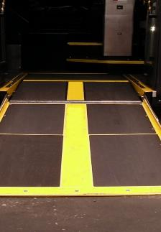
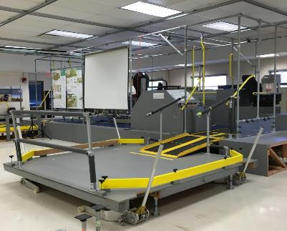
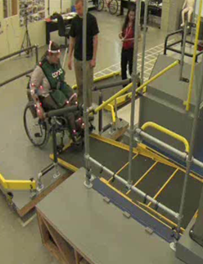
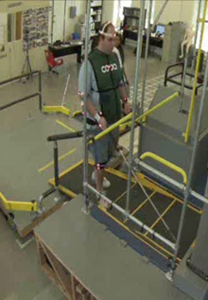
Study 2: Study Design (n=66)
Participant Group | n
Manual Wheelchair | 15
Power Wheelchair | 15
Scooter | 6
Cane/Service Animal (Vision Impaired) | 15
Walking Aid | 15

Slide 27
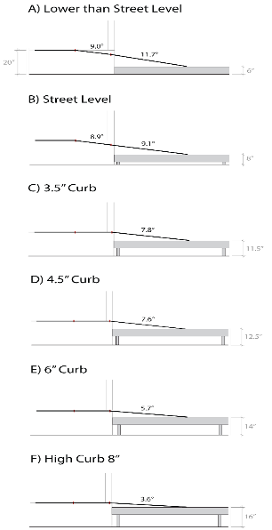
Study 2: Test Conditions
Ramp Condition | Segment Angle (rise:run equivalent)
 | Inside | Middle | Outside
A. Below Street Level | 1.2° - | 9.0° (1:6.3) | 11.7° (1:4.8)
B. Street Level | 1.3° - | 8.9° (1:6.4) | 9.1° (1:6.2)
C. 3.5" Curb | 1.3° - | 2.5° - | 7.8° (1:7.3)
D. 4.5" Curb | 1.3° - | 0.4° - | 7.6° (1:7.5)
E. 6" Curb | 1.3° - | 0.3° - | 5.7° (1:9.9)
F. High Curb 8” | 1.3° - | 0.3° - | 3.6° (1:15.7)

Slide 28
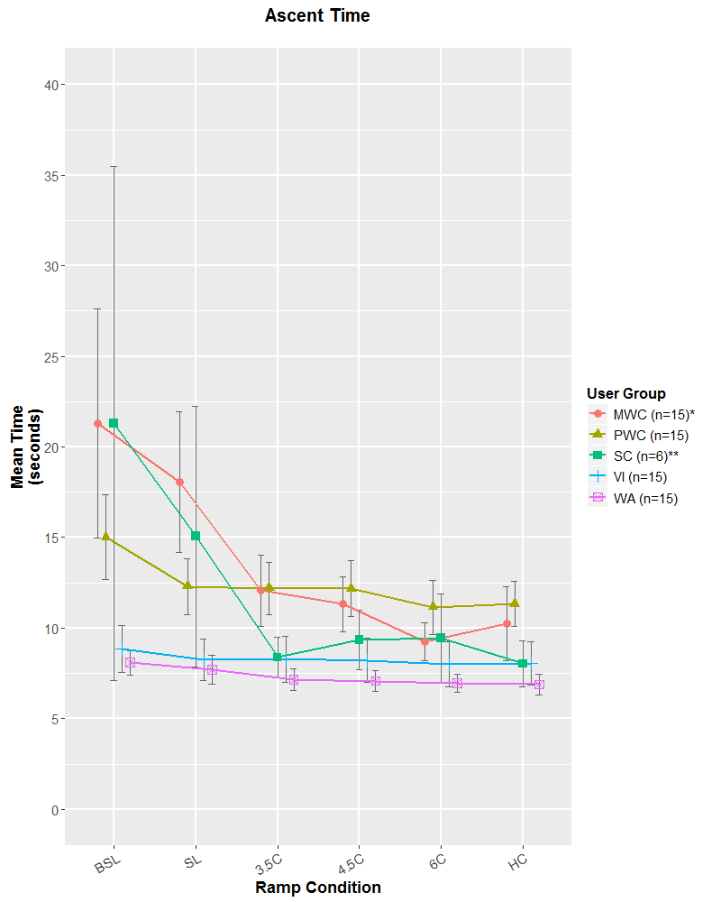
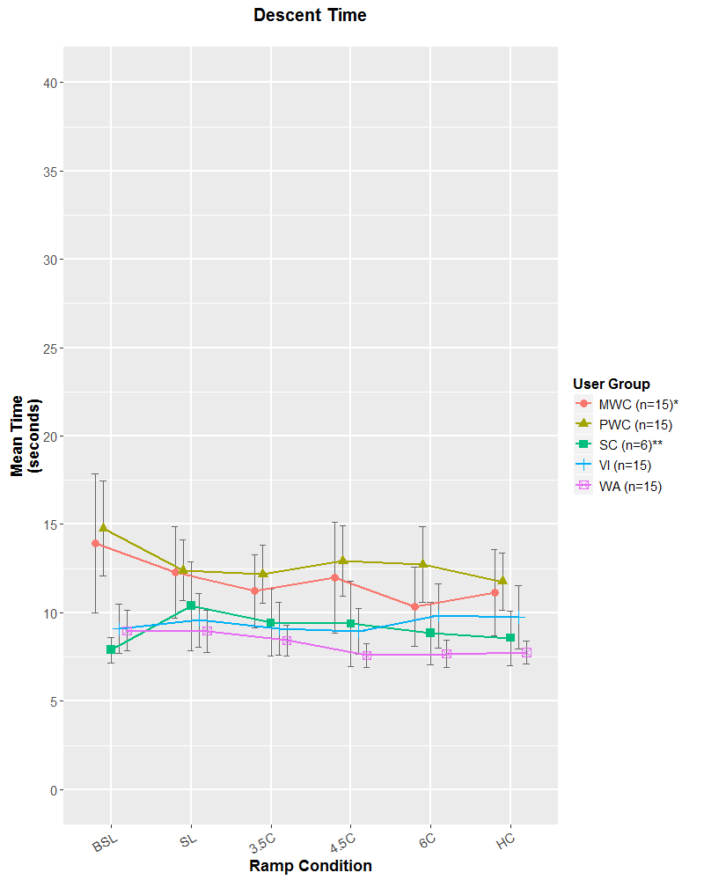
Study 2: Findings (Time)
Descent
Ascent

Slide 29
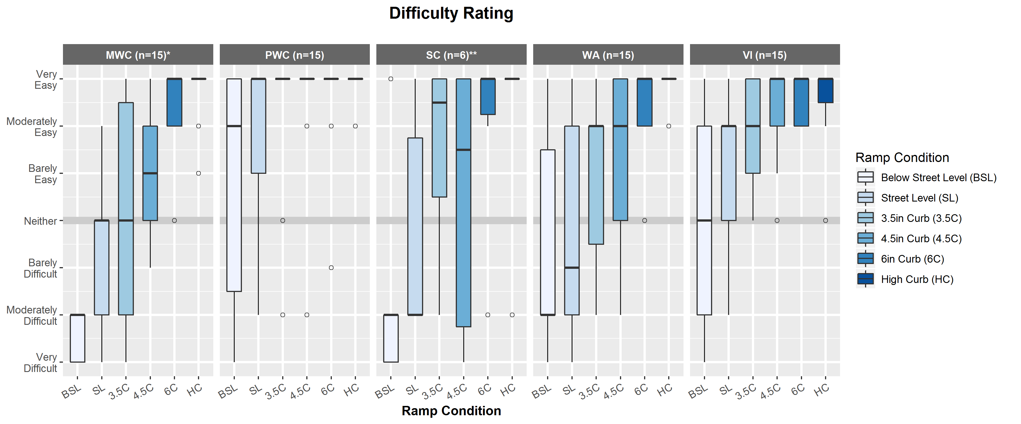
Study 2: Findings (Difficulty Ramp Ascent)

Slide 30
Study 2: Other Findings
20% of manual wheelchair users need assistance even on a 4.5 inch curb (steepest segment measures 1:7.5).
The challenging grade break conditions created with older (two-segment) ramps were alleviated by the three-segment ramp design.
Ramps should be designed to be at floor grade within the bus (i.e., do not cut into floor) to reduce trip and fall hazards and maximize clear spaces for turning and maneuvering.

Slide 31
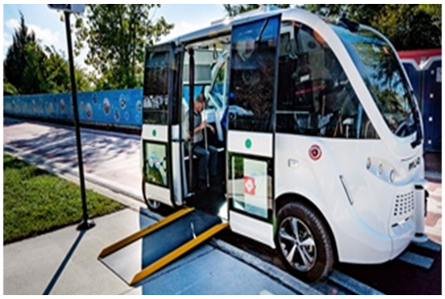
Research Implications for Self-Driving Vehicles
Our work supports a maximum slope for transit ramps of 1:6, with less severe slopes preferred to support independent ascent of manual wheelchair users.
With a 1:6 maximum condition at street level, any environmental facilitation will support easier entry and exit:
Deploy ramp to curb wherever possible, and ideally at corners or sidewalks that have enough clear space.
Standardize pick-up and drop-off conditions to allow loading to curb.

Slide 32
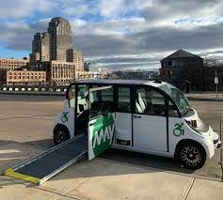
Other Implications for Self-Driving Vehicles
Automatic door and ramp deployment needs to be addressed.
Treat each passenger similarly
Automate to passengers’ preferences
Communicate deployment status to passenger
Appropriate ramp storage is challenging, but possible.
The pick-up and drop-off location ideally will be curb height but must have enough clearance to allow passengers to maneuver onto and off of the ramp easily.
E.g., Avoid deploying halfway onto a narrow sidewalk

Slide 33
Sponsor
This presentation was funded in part by grants from the National Institute on Disability, Independent Living, and Rehabilitation Research (NIDILRR) grant numbers H133E080019 and 90RE5011. NIDILRR is a Center within the Administration for Community Living (ACL), Department of Health and Human Services (HHS). The contents of this presentation do not necessarily represent the policy of NIDILRR, ACL, HHS, and you should not assume endorsement by the Federal Government.

Slide 34
Questions/ Comments
Victor Paquet, Sc.D.
Center for Inclusive Design and Environmental Access
University at Buffalo, Department of Industrial and Systems Engineering
341 Bell Hall | Amherst, NY 14221
vpaquet@buffalo.edu

Slide 35

Amy Schoppman
Director of Governmental Affairs
National Mobility Equipment Dealers Association
(NMEDA)

Slide 36


National Mobility Equipment Dealers Association

Slide 37

Kevin Frayne
Director of Advanced Mobility Solutions
BraunAbility

Slide 38
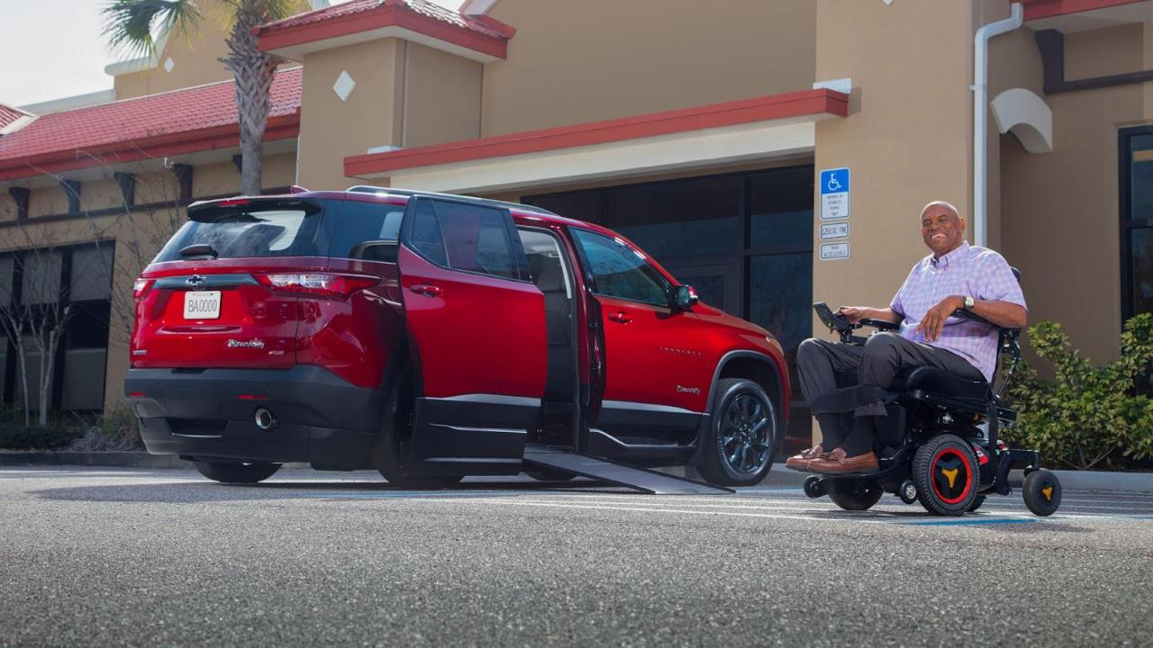

Kevin Frayne, Director of Advanced Mobility Solutions
Notes:
Introduce self – brief background and role at BraunAbility
-OEM automotive background of 30+ years at General Motors. At one time an engineer. Spent the majority of career in strategy, technology & product development - as well as consumer trends.
-At BraunAbility for a little over two years.
-I develop and implement strategies for wheelchair accessibility, focused on the future of transportation. A significant area of my focus is around Electric and Autonomous vehicles
I’m hopeful that what we’ve learned at BraunAbility over almost 60 years, combined with our investigation and work on EVs and AVs over the last few years, will bring some new perspectives to the future of accessible travel in Autonomous Vehicles

Slide 39

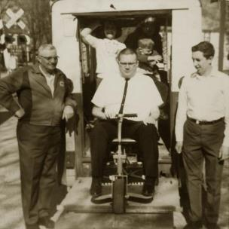

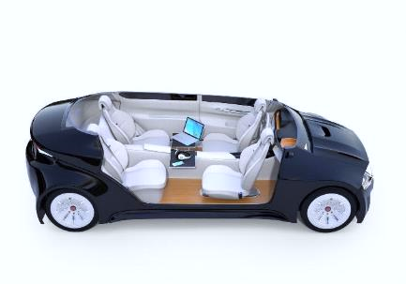
Accessible Transportation Milestones
Ralph Braun
AVs
1966
1990
202x
Notes:
Looking specifically at transportation, we see AVs as a continuation of the societal and technical changes that have improved the lives of those with disabilities.
Our own Ralph Braun created the company bearing his name out of necessity. Other wheelchair users, seeing his personal inventions, requested similar products, which eventually created BraunAbility
The passage of the ADA in 1990, besides requiring accessibility in all areas of society (including transportation), also defined the specific standards.
Repeating what many have already stated, Autonomous Vehicles has the potential to significantly change the lives of those with disabilities. Technology continues to be an enabler for improving the mobility of those in wheelchairs.

Slide 40

Topics
Accessible AVs: Evolution or Revolution?
A Geometry Refresher
Autonomous = Electric = Large Batteries
Notes:
I want to briefly hit on three topics today……

Slide 41

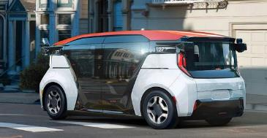
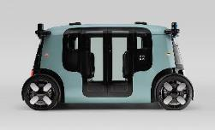

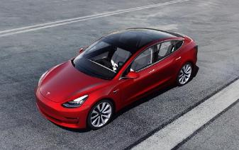

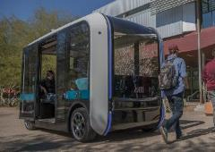
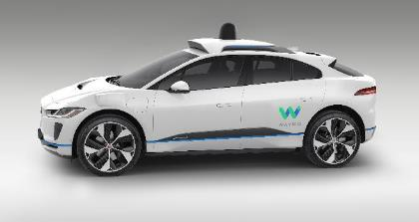
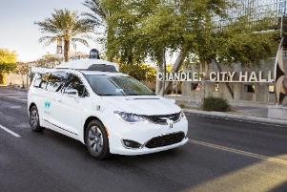
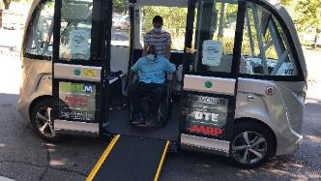

AVs: Evolution or Revolution?
Autonomous vehicles are: (a) like today’s vehicles; (b) reimagined transportation solutions; (c) electric; (d) privately owned; (e) shared; (f) multi-passenger public transportation; (g) all of the above.

Slide 42
AVs: Are Everything
(g) all of the above – and should be accessible
Notes:
Clarify that the information contained within is applicable to many different types of vehicles – and assumes change in vehicle architectures will likely be gradual.

Slide 43

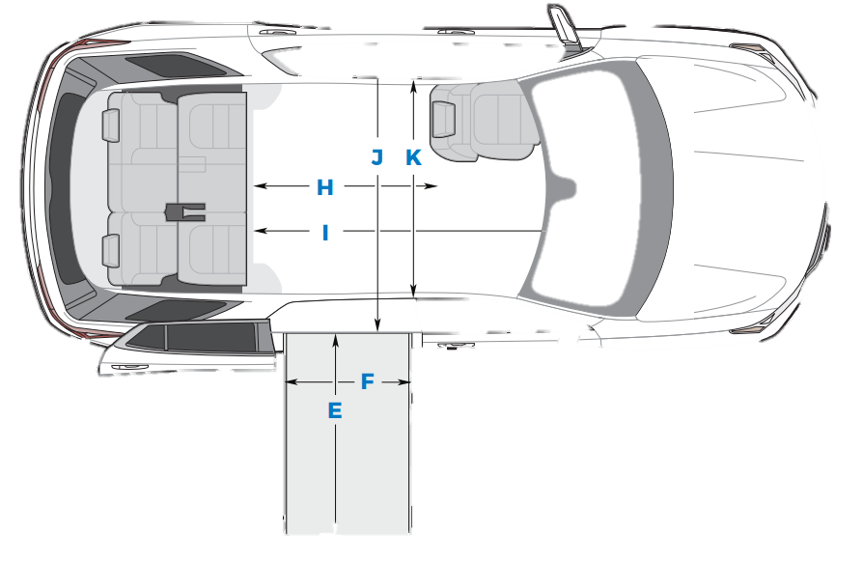
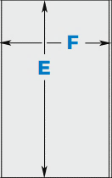

It’s All About the Geometry
10” / 250mm (or less) with kneeling is an “okay” place to be. 8” / 200mm is better.
Current ADA
Proposed ADA
1:4 / 14º Ramp
1:6 / 9.5º Ramp
Notes:
As AV/EV vehicles and architectures are developed, they still must adhere to the basic geometry of getting a wheelchair inside.
Today this usually is done via a ramp – which allows the wheelchair user to enter the same way as ambulatory passengers.

Slide 44
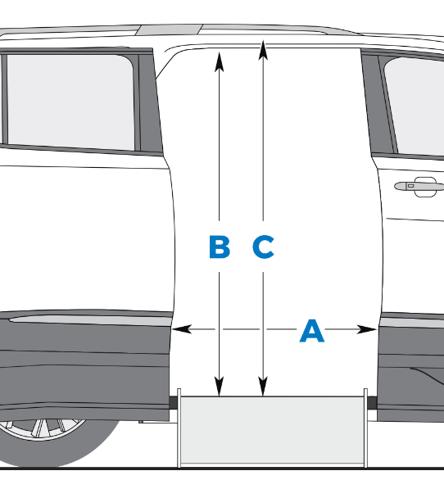
It’s All About the Geometry
Door Openings & Heights: Are greater than typically designed to for ambulatory usage
A: Door Width: ADA = 32” min.
B: Door Height: ADA = 56” min.
C: Interior Height: 59-61” min.
Notes:
As AV/EV vehicles and architectures are developed, they still must adhere to the basic geometry of getting a wheelchair inside.
Today this usually is done via a ramp – which allows the wheelchair user to enter the same way as ambulatory passengers.

Slide 45

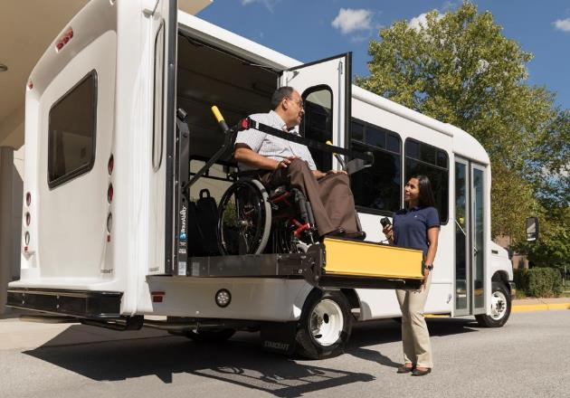
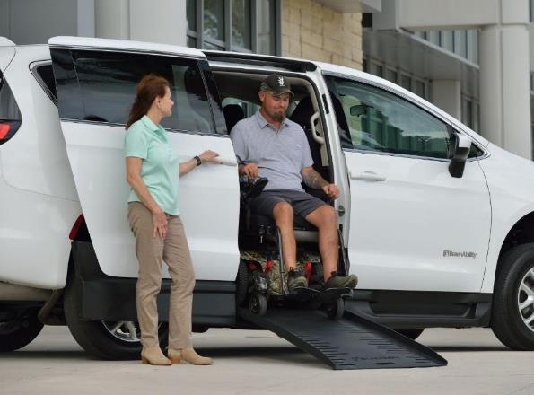
Step-In Height (including kneeling) drives a solution
Lifts do not lend themselves as easily to full autonomous operation
Rarely do ramps and lifts compete for an application

Slide 46
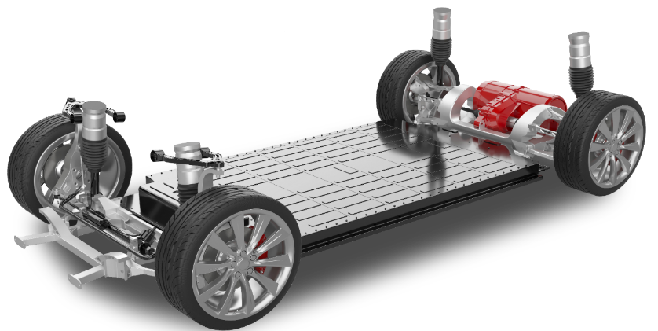
Batteries = New Challenges
Underfloor batteries constrain entry/exit solutions
Sometimes structural, almost never moveable
Have integrated liquid cooling systems
Precludes attaching lifts, ramps, and WC securement through the vehicle floor

Slide 47
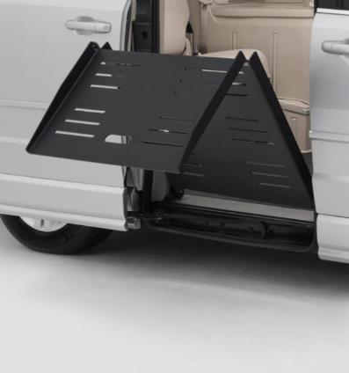
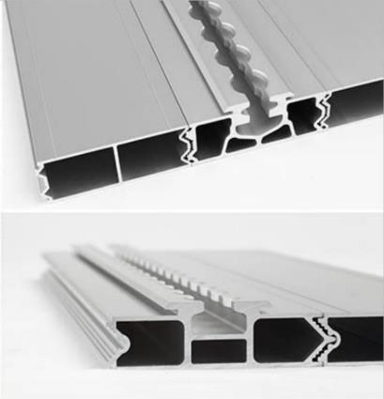
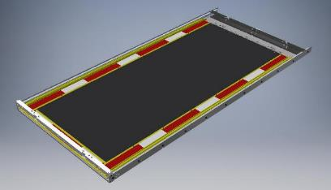
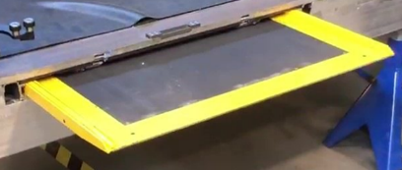
Batteries: Vehicle Accessibility Solutions
Go Above the Floor: On-floor fold-out ramp that attaches at the vehicle threshold.
Go On the Floor: Bonded (non-intrusive) flooring system that provides attachments for lifts, ramps, and WC securement solutions.
Go Below The Floor: 50mm slot (above batteries, below the floor) to accommodate an ultra-thin ADA ramp solution.
Evolutionary to Revolutionary Solutions
Notes:
Clarify that the information contained within is applicable to many different types of vehicles – and assumes change in vehicle architectures will likely be gradual.

Slide 48

Summary:
AVs - An Accessibility Evolution and Revolution
Innovate for the Now and the Later
100% automated vs. 100% accessible: Don’t wait for the first to do the second.
Step-In is Critical: New EV architectures will severely limit their ability to accommodate ramp solutions if this is ignored
AVs are EVs and have unique accessibility challenges (and solutions) due to batteries
Innovation

Slide 49

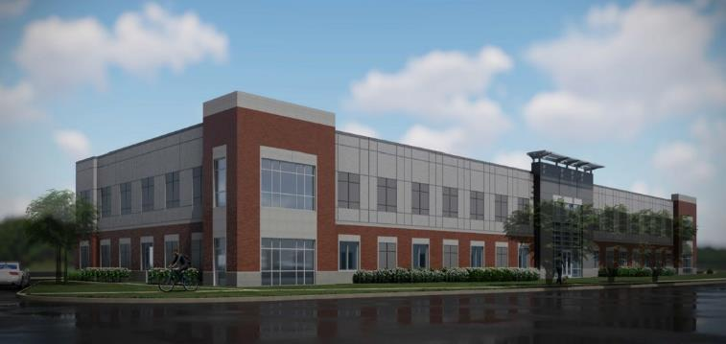
Carmel, IN Research & Development / Advanced Engineering Lab
Opening April 1, 2021
Advanced accessibility developments related to EVs, AVs, sensing, IoT, etc.
Purdue Autonomous Vehicle Accessibility project will be based here

Slide 50
Questions?

Slide 51

Open Discussion
Request to share information, ideas, or comments using Zoom’s Q & A feature:
Name (and organization)
Brief description of content
Host will enter you into que
Moderator will announce when you should unmute (*6 by phone)
Moderator will also announce next in que
Presenters may respond to some comments
Alternative: events@access-board.gov
ASL – note in request to comment
Please limit comments to < 3-5 min.

Slide 52
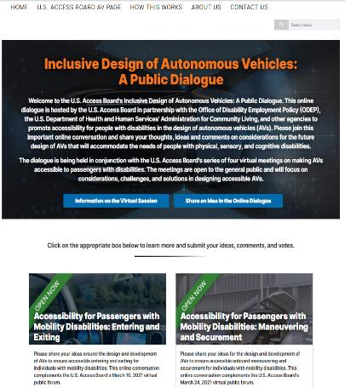
Online Dialogue
Continue the conversation Online
https://transportationinnovation.ideascale.com/
Share ideas, comment, vote
For assistance, email: ePolicyWorks@dol.gov

Slide 53
Next Session
Accessibility for Passengers with Mobility Disabilities: Part 2
This session will address maneuvering and securement in vehicles and continued discussion of entering and exiting autonomous vehicles.
March 24, 2021, 2:00 – 3:30 (ET)
Welcome remarks by Jennifer Sheehy, Deputy Assistant Secretary of Office of Disability Employment Policy, Department of Labor.
Presenters:
Scott Windley, U.S. Access Board
Bryan Brillhart, Robotics Research
Dr. Kathleen D. Klinich, University of Michigan
Dr. Jordana Maisal, University at Buffalo

